Slide 1
Lecture 05
Indirectness in writing

Slide 2
Indirectness in writing
When a message is primarily bad news, you should probably write in the indirect order.
The indirect order is especially effective when you must say “no” or convey other disappointing news.
The main reason for this approach is that negative news is received more positively when an explanation precedes it.
An explanation may even convince the reader that the writer’s position is correct.

Slide 3
Indirectness in writing
In addition, an explanation cushions the shock of bad news.
Not cushioning the shock makes the message unnecessarily harsh, and harshness destroys goodwill.
The only exceptions are when the bad news is routine or when the reader prefers frankness.
But such instances are less common than those in which indirectness is the preferable strategy.

Slide 4
General indirect plan

Slide 5
Strategic buffer
Begin with a strategic buffer -
By buffer we mean an opening that identifies the subject of the message but does not indicate overtly that negative news is coming.
That is, it raises the topic of the message but does not indicate what the rest of the message will say about it.
A buffer can be neutral or positive.
A neutral buffer might simply acknowledge your receipt of the reader’s earlier message and indicate your awareness of what it said.

Slide 6
Strategic buffer
A positive buffer might thank the reader for bringing a situation to your attention or for being a valued customer or employee.
Use care when opening on a positive note. You do not in any way want to raise the reader’s hopes that you are about to deliver the news that he or she may be hoping for.
A gradual introduction to the message’s main negative point gives them a chance to prepare for the news.
And even if they suspect that it will be negative, the use of a buffer indicates consideration for their feelings.

Slide 7
2. Explanation
Follow the buffer with an explanatory strategy before presenting the negative news. This helps present your reasons in such a way that your reader will accept the news as positively as possible.
Your strategy might be to explain the fairness of a certain action.
It might be to present facts that clearly make the decision necessary.
Or you might cite the expert opinion of authorities whom both you and your reader respect.

Slide 8
2. Explanation
It might even be possible to show that your reasons for the negative decision actually will benefit the reader in the long run.

Slide 9
3. The bad news
Next, you present the bad news as positively as you can.
If you have developed your reasoning convincingly, this bad news should appear as a logical outcome.
Avoid second person to reduce the negative impact -
Ex - “Since you have broken the seal, state law prohibits us from returning the product to stock.”
A better alternative -
“State law prohibits us from returning to stock all products with broken seals.”

Slide 10
3. The bad news
Or, you can link negative news to a reader benefit to lessen the sting.
For example, if you preface a company policy with “in the interest of fairness” or “for the safety of our guests,” you are indicating that all of your patrons, including the reader, get an important benefit from your policy.

Slide 11
4. Offering an alternative
For almost any negative-news situation that you can think of, there is something you can do to help the reader with his or her problem. For Ex -
If someone seeks to hold an event on your company grounds and you must say no, you may be able to suggest other sites.
If someone wants information that you cannot give, you might know of another way that he or she could get similar information.

Slide 12
4. Offering an alternative
If you cannot volunteer your time and services, perhaps you know someone who might, or perhaps you could invite the reader to make the request again at a later, better time.
If you have to announce a cutback on an employee benefit, you might be able to suggest ways that employees can supplement this benefit on their own.
Taking the time to help the reader in this way is a sincere show of concern for the reader’s situation.
For this reason, it is one of your most powerful strategies for maintaining goodwill.

Slide 13
5. Ending on a positive note
Since even a skillfully handled bad-news message can be disappointing to the reader, you should end the message on a forward-looking note.
Your goal here is to shift the reader’s thoughts to happier things—perhaps what you would say if you were in face-to face conversation with the person.
Preferably your comments should fit the one case (i.e., should not be a “rubber stamp expression”, and they should not recall the negative message.

Slide 14
Contrasting Examples: Refused requests

Slide 15
Refused request
Assume the role of assistant to the Pinnacle vice president.
Today your boss assigned you the task of responding to a request from the local chapter of the National Association of Peace Officers.
This worthy organization has asked Pinnacle to contribute to a scholarship fund for certain needy children.
The request is persuasive. It points out that the scholarship fund is terribly short. As a result, the association is not able to take care of all the needy children.

Slide 16
Refused request
Many of them are the children of officers who were killed in the line of duty.
You have been moved by the persuasion, and you would like to comply, but you cannot. You cannot contribute now because Pinnacle policy does not permit it.
Even though you do not like the effects of the policy in this case, you think the policy is good. Each year Pinnacle earmarks a fixed amount—all it can afford— for contributions. Then it donates this amount to the causes that a committee of its executives considers the most worthy.

Slide 17
Refused request
Unfortunately, all the money earmarked for this year has already been given away.
You will have to say no to the request, at least for now. You can offer to consider the association’s cause next year. Your response must report the bad news, though it can hold out hope for the future.
Because you like the association and because you want it to like Pinnacle, you will try to handle the situation delicately. The task will require your best strategy and your best writing skills.

Slide 18
Refused request
The general indirect plan is to be followed here.
Since this is a refusal message, make sure that you refuse politely. Harsh words such as I refuse, will not, and cannot stand out.
So do such timeworn apologies as “I deeply regret to inform you . . .” and “I am sorry to say. . . .”
You can usually phrase your refusal in terms of a positive statement of policy.

Slide 19
Refused request
For example, instead of writing “your insurance does not cover damage to buildings not connected to the house,” write “your insurance covers damage to the house only.”
Or instead of writing “We must refuse,” a wholesaler could deny a discount by writing “We can grant discounts only when. . . .”
In some cases, your job may be to educate the reader. Not only will this be your explanation for the refusal, but it will also build goodwill.

Slide 20
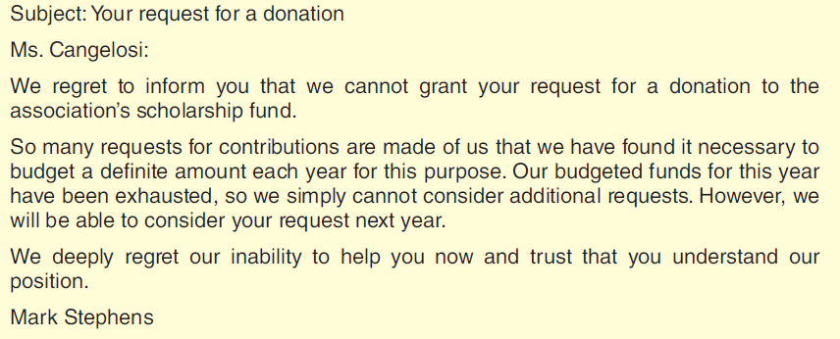
Refused request: Bad example

Slide 21
Refused request: Bad example
Harshness in the Direct Refusal - This example states the bad news right away.
This blunt treatment puts the reader in an unreceptive frame of mind. The result is that the reader is less likely to accept the explanation that follows.
The explanation is clear, but note the unnecessary use of negative words ( exhausted, regret, cannot consider ).
Note also how the closing words leave the reader with a strong reminder of the bad news.

Slide 22
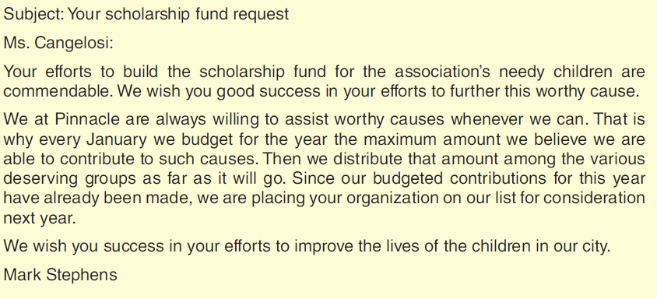
Refused request: Good example

Slide 23
Refused request: Good example
Tact and Courtesy in an Indirect Refusal - This example skillfully handles the negative message.
Its opening words are on subject and neutral. They set up the explanation that follows.
The clear and logical explanation ties in with the opening. Using no negative words, the explanation leads smoothly to the refusal.
Note that the refusal also is handled without negative words and yet is clear. The friendly close fits the one case.

Slide 24
Claims

Slide 25
Claims
When something goes wrong between a business and its customers, usually someone begins an effort to correct the situation.
Typically, the offended party calls the matter to the attention of those responsible.
It is risky to make your actual request for an adjustment before you have presented the facts of the case.
Hence I suggest getting directly to the problem but delaying the actual request for an adjustment.

Slide 26
Claims
Focus as much as possible on facts, not feelings. are completely in the right, you will not advance your cause with accusatory, one sided language.

Slide 27
Leading into the Problem in the Beginning
Claim message needs to identify the transactions involved. This you can do early in the subject head of an email or a letter, or in the opening paragraph.
Example:
Subject: Damaged condition of fire extinguishers on arrival, your invoice C13144.
OR
Today we received via FedEx Ground the fire extinguishers we ordered on 5 May 2009 (invoice # C13144). Seven of the 35 extinguishers arrived in damaged condition.

Slide 28
Leading into the Problem in the Beginning
Choose your words with care. Avoid negatively charged words as complaint or disappointment can put your readers on the defensive before you’ve even had a chance to make your case.

Slide 29
2. Describing the Problem Clearly
Include concrete evidence to support your claim.
The words describing the problem should be courteous yet firm. And they should cover the problem completely, giving enough information to permit the reader to judge the matter.
Ex - The Model H freezer (Serial No. 713129) that we bought from you September 17 suddenly quit working. As a result, $517 of frozen foods were ruined.
Notice that this example uses the passive voice. It says “. . . were ruined” rather than “your freezer ruined. . . .” This sentence type keeps the second person ( you , your ) out of the most negative part of the message, helping you avoid accusations.

Slide 30
2. Describing the Problem Clearly
Notice that this example uses the passive voice. It says “. . . were ruined” rather than “your freezer ruined. . . .”
This sentence type keeps the second person ( you , your ) out of the most negative part of the message, helping you avoid accusations.

Slide 31
3 and 4
3. Requesting the Correction
Request what you think is fair—or leave it to your reader to decide.
4. Overcoming Negativeness with a Fair-Minded Close
Your final friendly words should leave no doubt that you are trying to maintain a positive relationship. For added strength, you could express appreciation for what you seek.

Slide 32
3 and 4
Don’t use the timeworn “Thanking you in advance.”
Instead, say something like “I would be grateful if you could get the new merchandise to me in time for my Friday sale.”
Whatever final words you choose, they should clearly show that yours is a firm yet cordial and fair request.

Slide 33
Contrasting examples

Slide 34
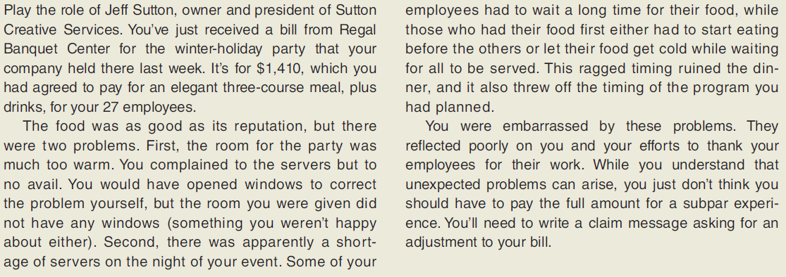
Scenario

Slide 35
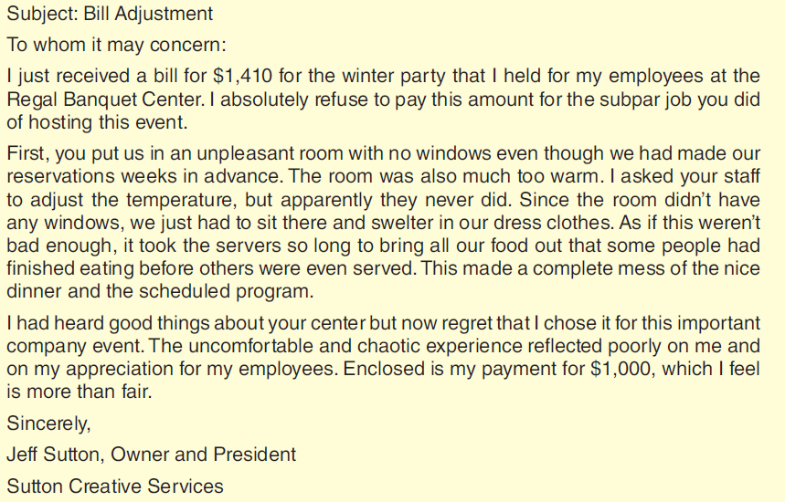
Contrasting examples

Slide 36
Contrasting examples
A Blunt and Harsh Message - From the very beginning, the message is insulting. “To whom it may concern” shows that the writer does not regard the reader as a person.
The opening paragraph is a further affront, blurting out the writer’s stance in angry language.
The middle of the message continues in this negative vein, accusing the reader with you and your and using emotional language.
The negative writing continues into the close, leaving a bad final impression. Such wording is more likely to produce resistance than acceptance.

Slide 37
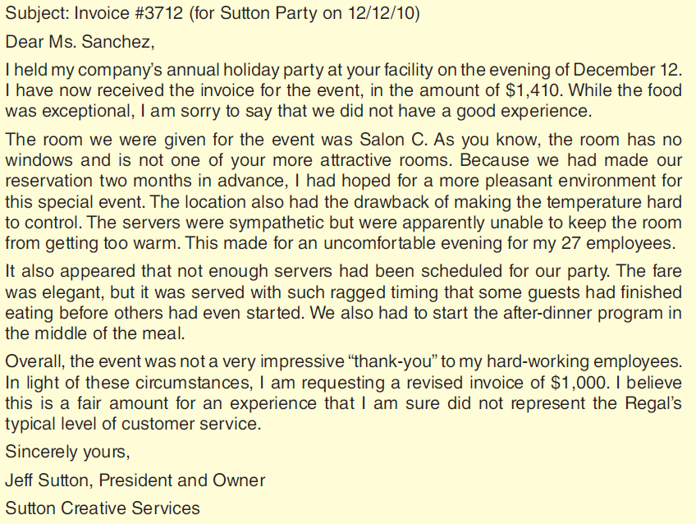

Slide 38
Contrasting examples
A Firm Yet Courteous Message - The message follows the plan suggested in preceding slides.
A subject line quickly identifies the situation.
The claim message begins with a lead-in to the problem.
Next, in a tone that shows firmness without anger, it tells what went wrong. Then it requests a specific remedy.
The ending uses subtle persuasion by implying confidence in the reader. The words used here leave no doubt about the writer’s interest in a continued relationship.

Slide 39
Adjustment refusals

Slide 40
Adjustment refusals
Specific plan for adjustment refusals:
Begin with words that are on subject, are neutral about the decision, and set up your strategy.
Present the strategy that explains or justifies, being factual and positive.
Refuse clearly and positively, perhaps including a counterproposal.
End with off-subject, positive, forward-looking, friendly words.

Slide 41
Contrasting examples

Slide 42
Scenario
Sometimes your job at Pinnacle involves handling a complaint. Today you have to do that, for the morning email has brought a strong claim for adjustment on an order for Pinnacle’s Do-Craft fabrics.
The claim writer, Ms. Arlene Sanderson, explains that a Do-Craft fabric her upholstering company used on some outdoor furniture has faded badly in less than 10 months.
She even includes photographs of the fabric to prove her point.

Slide 43
Scenario
She contends that the product is defective, and she wants her money back—all $2,517 of it.
Inspection of the photographs reveals that the fabric has been subjected to strong sunlight for long periods.
Do-Craft fabrics are for inside use only. Both the Pinnacle brochures on the product and the catalog description stress this point. In fact, you have difficulty understanding how Ms. Sanderson missed it when she ordered from the catalog.

Slide 44
Scenario
Anyway, as you see it, Pinnacle is not responsible and should not refund the money.
At the same time, it wants to keep Ms. Sanderson as a repeat customer.
Now you must write the message that will do just that. The following discussion tells you how.

Slide 45
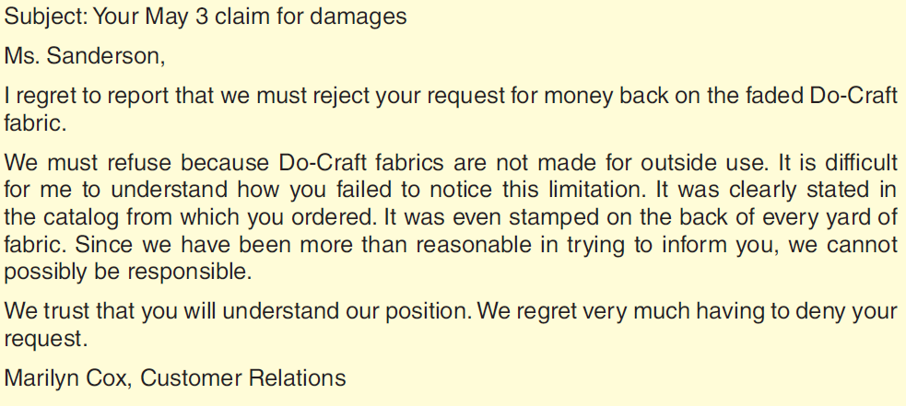
Scenario
Anyway, as you see it, Pinnacle is not responsible and should not refund the money.
At the same time, it wants to keep Ms. Sanderson as a repeat customer.
Now you must write the message that will do just that. The following discussion tells you how.

Slide 46
Contrasting example
Bluntness in a Direct Refusal - The bad email begins bluntly with a direct statement of the refusal.
The language is negative (regret, must reject, claim, refuse, damage, inconvenience ).
The explanation is equally blunt. In addition, it is insulting (“It is difficult to understand how you failed . . .”). It uses little tact, little you-viewpoint.
Even the close is negative, for it recalls the bad news.

Slide 47

Contrasting example

Slide 48
Contrasting example
Tact and Indirect Order in a Courteous Refusal - The good message begins with friendly talk on a point of agreement that also sets up the explanation.
Without accusations, anger, or negative words, it reviews the facts of the case, which free the company of blame.
The refusal is clear, even though it is made by implication rather than by direct words.

Slide 49
Contrasting example
It uses no negatives, and it does not receive undue emphasis.
The close shifts to helpful suggestions that fit the one case— suggestions that may actually result in a future sale.
Friendliness and resale are evident throughout the message, but especially in the close.

Slide 50
Negative announcements: contrasting examples

Slide 51
Negative announcements
In your role as assistant to Pinnacle’s vice president for administration, you have been given the difficult assignment of writing a bad-news message for your boss.
She has just returned from a meeting of the company’s top executives in which the decision was made to deduct 25 percent of the employees’ medical insurance premiums from their paychecks.
Until now, Pinnacle has paid it all. But the rising cost of health coverage is forcing the company to cut back on these benefits, especially since Pinnacle’s profits have declined for the past several quarters.

Slide 52
Negative announcements
Something has to give if Pinnacle is to remain competitive while also avoiding lay-offs.
The administrators decided on a number of cost-cutting measures including this reduction in Pinnacle’s payment for medical insurance.
The message you will write to Pinnacle employees is a negative announcement.

Slide 53
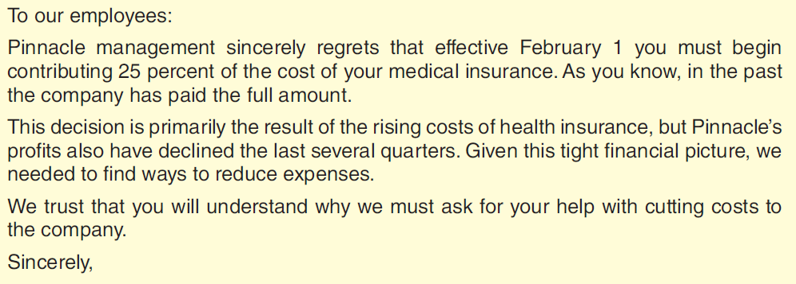
Negative announcements
Something has to give if Pinnacle is to remain competitive while also avoiding lay-offs.
The administrators decided on a number of cost-cutting measures including this reduction in Pinnacle’s payment for medical insurance.
The message you will write to Pinnacle employees is a negative announcement.

Slide 54
Negative announcements
Directness Here Alarms the Readers - This bad example clearly upsets the readers with its abrupt announcement in the beginning.
The readers aren’t prepared to receive the negative message. They probably don’t understand the reasons behind the negative news.
The explanation comes later, but the readers are not likely to be in a receptive mood when they see it.
The message ends with a repetition of the bad news.

Slide 55
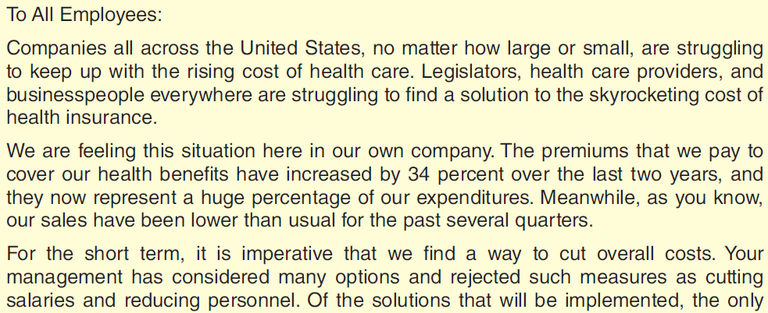
Negative announcements
Directness Here Alarms the Readers - This bad example clearly upsets the readers with its abrupt announcement in the beginning.
The readers aren’t prepared to receive the negative message. They probably don’t understand the reasons behind the negative news.
The explanation comes later, but the readers are not likely to be in a receptive mood when they see it.
The message ends with a repetition of the bad news.

Slide 56
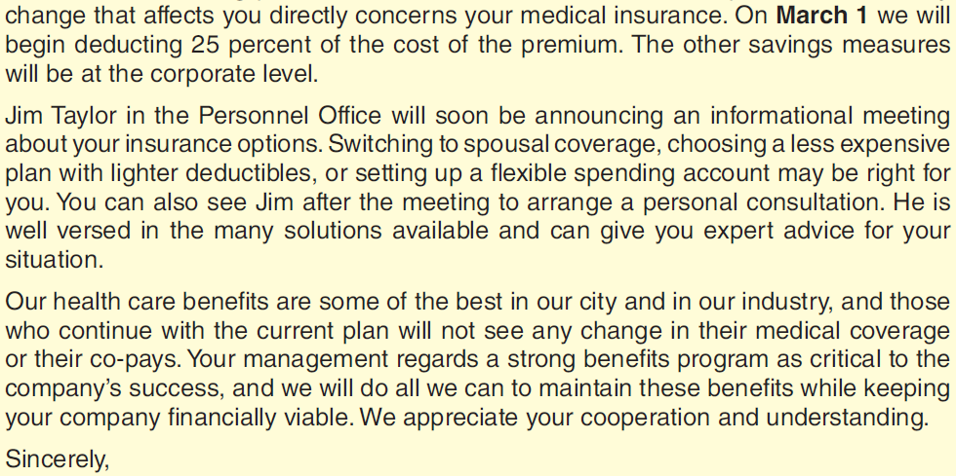
Negative announcements
Directness Here Alarms the Readers - This bad example clearly upsets the readers with its abrupt announcement in the beginning.
The readers aren’t prepared to receive the negative message. They probably don’t understand the reasons behind the negative news.
The explanation comes later, but the readers are not likely to be in a receptive mood when they see it.
The message ends with a repetition of the bad news.

Slide 57
Negative announcements
Convincing Explanation Begins a Courteous Message - The better example follows the recommended indirect pattern.
Its opening words begin the task of convincing the readers of the appropriateness of the action to be taken.
After more convincing explanation, the announcement flows logically. Perhaps it will not be received positively by all recipients, but it is a reasonable deduction from the facts presented.

Slide 58
Negative announcements
After the announcement comes an offer of assistance to help readers deal with their new situation.
The last paragraph reminds readers of remaining benefits and reassures them that management understands their interests. It ends on an appreciative, goodwill note.

Slide 59
Discussion & debate

Slide 60
Discussion & debate
Give examples of times (or situations) when directness is appropriate for responses giving negative (bad-news) information.
Writing in the indirect order usually requires more words than does writing in the direct order. Since conciseness is a virtue in writing, how can the indirect order be justified?
What strategy is best in a message refusing a request when the reasons for the refusal are strictly in the writer’s best interests?

Slide 61
Discussion & debate
“Apologies in refusals are negative because they call attention to what you are refusing. Thus, you should avoid using them.” Discuss.
Explain how a claim message can be both direct and indirect.
“If I’m not emotional in my claim messages, the readers won’t understand how upset I am.” Respond to this statement.
Some business writers explain an adjustment refusal simply by saying that company policy did not permit granting claims in such cases. Is this explanation adequate? Discuss.

Slide 62
Discussion & debate
Negative announcements usually need to include much more than the announcement. Explain.
Give examples of negative announcements that appropriately are written in the direct order.

Slide 63
Exercises

Slide 64
Exercises
Point out the shortcomings in the following email message from a sports celebrity declining an invitation to speak at the kickoff meeting for workers in a fund-raising campaign for a charity.
Subject: Your request for free lecture
Ms. Chung:
As much as I would like to, I must decline your request that I give your membership a free lecture next month. I receive many requests to give free lectures. I grant some of them, but I simply cannot do them all. Unfortunately, yours is one that I must decline.

Slide 65
Exercises
I regret that I cannot serve you this time. If I can be of further service in the future, please call on me.
Sincerely yours,

Slide 66
Exercises
Criticize the following message refusing the claim for a defective riding lawn mower. The mower was purchased 15 months earlier. The purchaser has had difficulties with it for some time and submitted with the claim a statement from a local repair service verifying the difficulties. The writer’s reason for refusing is evident from the email.
Subject: Your May 12 claim
Mr. Skinner:
Your May 12 claim of defective workmanship in your Model 227 Dandy Klipper riding mower has been reviewed. After

Slide 67
Exercises
considering the information received, I regret to report that we cannot refund the purchase price.
You have had the mower for 15 months, which is well beyond our one-year guarantee. Even though your repair person says that you had problems earlier, he is not one of our authorized repair people.
If you will read the warranty you refer to in your letter, you will see that we honor the warranty only when our authorized repair people find defects. I think you will understand why we must follow this procedure. If you will take the machine to the authorized service center in your area (La Rue Lawn and

Slide 68
Exercises
Garden Center), I am confident they can correct the defect at a reasonable charge.
If I can be of additional service, please contact me.
Sincerely,

Slide 69
Exercises
You work for an online mail-order company, Nonsensicals, that sells such novelty items as t-shirts with clever sayings, unique toys and games, and such household accessories as framed posters and retro table lamps. Most of the employees are young, somewhat quirky, and very Internet savvy. Now consider the following email sent to everyone from the company president:
Subject: No More Social Networking during Work Hours
It has become obvious to me that people are spending too much time doing social networking and not enough time actually working while on the job. From now on, you must do

Slide 70
Exercises
your networking (whether on MySpace, Facebook, LinkedIn, or any other such network) on breaks or during other personal time. Anyone found using these websites on company time will receive an official reprimand.
Considering the advice in this chapter, what would be the main ways to improve this negative announcement?

Slide 71
Thank you!

